Slide 1
IOT Based car parking monitoring system using Arduino and vb.Net

Slide 2
Introduction
The aim of this project is to help the people to get the vacant slot for car parking.
It will help people with car parking by showing how many vacant place is their to park the car.
With the help of computer application we are going to monitor the parking system.

Slide 3
Special Key Points:
The project’s main purpose is produce a real life solution to the car parking problem which is frequently facing by the people.
People usually roam around in a parking lots trying to find a suitable place to park in.
It will help the guards, parking managers or people to keep the record how many cars are parked in slot and how many vacant slots are there.
It will also saves time. It's a computer application so in few seconds its going to be refresh and shows the status of parking slots.
It will also acknowledge how to program Arduino and make it work on system.

Slide 4
Details
The project is based on Arduino , IR sensors and vb .NET. Total six IR sensors are going to be used in this project.
The car parking area are divided into two parking areas , Parking1 and Parking2.
Each parking slot has an IR sensors, which is used for the car detection.
Depending on the detection of the car the box next to the slot is checked or unchecked.
If the box is checked it means the slot is occupied by a car.

Slide 5
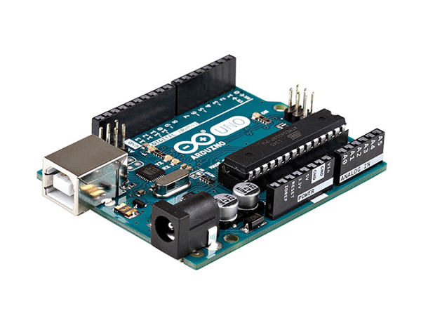
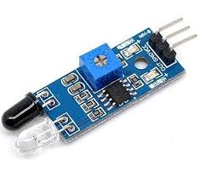
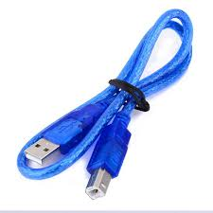
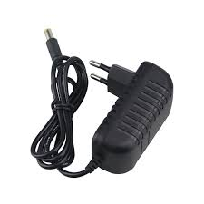
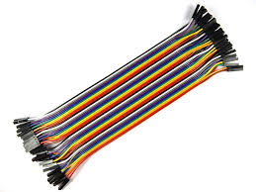
Components used
Arduino
IR Sensors
Connecting wires
Data Cable
Charger
Laptop or PC

